Slide 1
Titanic:Machine Learning from disaster
Kaggle Assignment

Slide 2
1. Business Understanding
On April 15, 1912, during her maiden voyage, the widely considered “unsinkable” RMS Titanic sank after colliding with an iceberg. Unfortunately, there weren’t enough lifeboats for everyone onboard, resulting in the death of 1502 out of 2224 passengers and crew.
While there was some element of luck involved in surviving, it seems some groups of people were more likely to survive than others.
In this assignment I will try to build a predictive model that answers the question: “what sorts of people were more likely to survive?” using passenger data (ie name, age, gender, socio-economic class, etc)

Slide 3
2. Analytic Approach
According to the records, the "women and children first" protocol was followed when loading the lifeboats. Most of the male passengers and crew were left aboard.
It is also known that First-Class passenger had priority when loading the lifeboats.
Thus, I will start with the following assumptions:
  Women were more likely to have survived.
  Children were more likely to have survived.
  The First-Class passengers were more likely to have survived.
More assumptions will be made later based on EDA

Slide 4
3. Data Requirements/Data Collection
A training and a test dataset has been provided for this assignment. They include information about:
PassengerId, Name, Passenger Class, Sex, Age, Nr. of siblings / spouses aboard the Titanic, Nr. of parents / children aboard the Titanic, Ticket number, Passenger fare, Cabin number, Port of Embarkation
The training set contains additional information about the survival of the passengers (1-survived, 0-didn‘t survived)

Slide 5
4. Data Understanding
By describing and by playing a bit with the data I made the following conclusions:
  There are 891 passengers in the training set(40% of the nr of passengers on board)
  38% of passengers in the sample survived
  Average age of passengers was 30
  Name is a unique value
  Sex variable has two value(female/male)
  Most of the people on board were men
  Passenger embarked from 3 docks. S is the most common
  Many people were sharing a cabin

Slide 6
  The passenger class is negatively correlated with survival while fare is positively correlated. This means passengers from upper-classes were more likely to survive.
  Age is negatively correlated as well.
  Female passengers have a higher probabiliy to survive
  Passenger with 1 sibling/spouse aboard were more likely to survive. The more siblings, the lower the chance. This can also be linked with status/class
  Those who embarked from dock C had higher chance of surviving
  Babies, young children and passengers with age between 20-40 were more likely to survive

Slide 7
5. Data Preparation
I have created a dataframe with the dependent variables I have chosen for analysis. I have decided to drop the variables Ticket and Cabin as they contain many unique values and there are lots of values missing.
I checked how many values and for which variables are missing
I replaced the missing values: age with average age, fare with median value, dock with most common dock C
I transformed the dock values (S,C,Q) with int values (0,1,2)

Slide 8
6. Modelling
I have chosen Logistic Regression for Modelling because:
  It is a classification problem
  A linear relationship between variables was not guaranteed
  I want to predict a binary, categorical value: Survived (0/1)
Other Model Assumptions:
  Independant observations
  Large sample size
  No need for linear relationship between dependent and independent variables
  No extreme outliers

Slide 9
Logistic Regression
WHAT: A way of measuring the relationship between a dependant and an independent variable
WHY: To estimate the probability of a binary response based on predictor variable/s

Slide 10


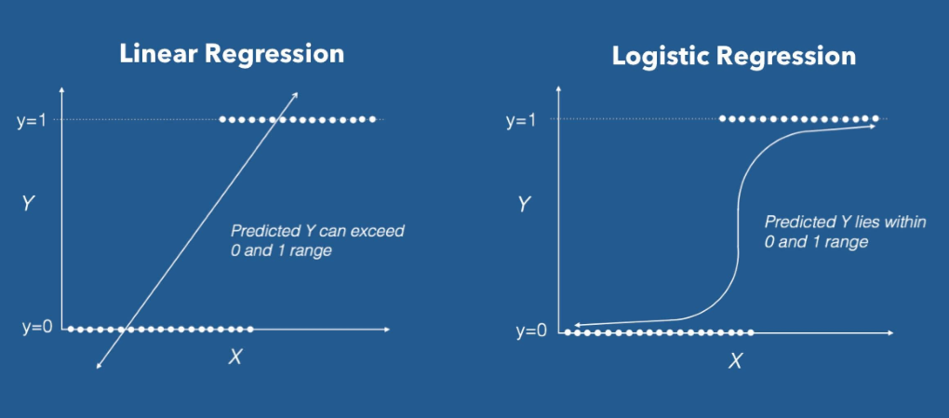

Linear Regression Function
Logistic Regression Function
Sigmoid Function

Slide 11


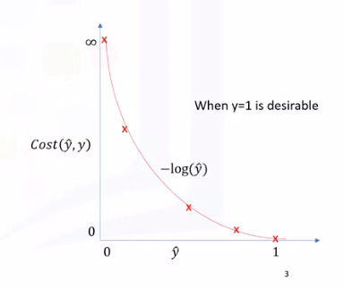
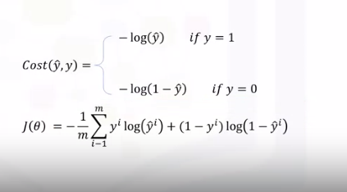
HOW:
1. Calculate the cost function
2. Minimize the Cost Function.
Linear regression's cost function cannot be used in logistic regression problems.
Find the Function which has the same behaviour but it is easier to find ist minimum point

Slide 12
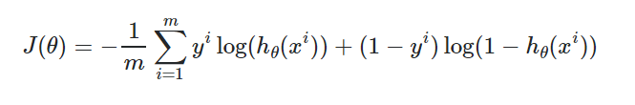
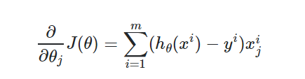
MODEL OPTIMIZATION WITH GRADIENT DESCENT:
1. Calculate the partial derivative for the Cost Function:
2. Pick random values for parameters and plung into the derivatives
3. Calculate Step Size for each derivative:
Step size= O*learning rate
4. Calculate new parmeters for each derivative:
New parameter=old parameter - step size

Slide 13
7. Evaluation
To evaluate the accuracy of the model I have calculated the confidence score generated by the model based on our training dataset. The value was 73.63
This value means that the predicted values matched the actual values in 73.63% of the cases

Slide 14
8. Conclusion
The accuracy score shows that there is still room for improvement
I can try other machine learning models on this data set: SVM, Decision Trees, Random Forest
I can try using other Classification Metrics: Confusion Matrix, Log Loss (do I have to transform the independant values in binary values?)

